Slide 1
Different gaze strategies during eye versus hand tracking of a moving target
Danion and Flanagan, 2018
Duncan Tulimieri

Slide 2
Introduction
Eyes guide hands
Pointing accuracy is altered when saccade is prevented
Underlying assumption
Efferent and/or afferent signals related to gaze facilitate transformation from retinotopic to body-centered reference frame to promote accuracy of movement

Slide 3
Introduction
Fixating target allows for more accurate movement
Far from target – use peripheral vision to provide error signal
Near target – guide hand
What about dynamic/tracking movements?
Track moving target with eyes
Concurrently track target with eyes and hand
Intercept target with hand along predictable or unpredictable trajectory
Free gaze?

Slide 4
Introduction
Main objective: Free gaze paradigm
Gaze behavior when continuously tracking moving target with hand, but without explicit instructions about gaze
Investigate whether gaze behavior is driven by different strategies when the goal of the task is to track a moving target as accurately as possible with the eyes or with the hand

Slide 5
Introduction
Eye tracking during dynamic target tracking
Smooth pursuits + catch up saccades when position/velocity error increase
If fixating a static target improves reaching accuracy, then it should be advantageous (increase accuracy) to fixate a moving target
Gaze should mainly focus mostly on target
Other behavioral predictions
Hand tracking: more smooth pursuits, less catch-up saccades
Retinal and extra-retinal information lost during saccades (saccadic suppression)

Slide 6
Introduction
Prediction during hand tracking: increase smooth pursuit, decrease catch up saccades
^ confirmed in instructed gaze paradigms
Unknown if a result of instruction or hand tracking

Slide 7
Methods
Participants
N = 18
Apparatus
KINARM Exoskeleton
Visuals:
Target (HAND&EYE -TRACK)
Cursor (HAND-TRACK)
Fig 1.

Slide 8
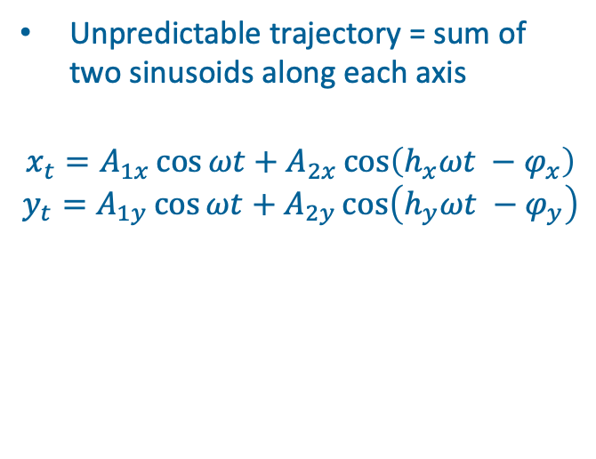
Methods
Unpredictable trajectory = sum of two sinusoids along each axis
$$x_{t}=A_{1x}\cos{ωt}+A_{2x}\cos\left(h_{x}ωt −φ_{x}\right)$$
$$y_{t}=A_{1y}\cos{ωt}+A_{2y}\cos\left(h_{y}ωt −φ_{y}\right)$$
Fig 2.
Table 1.
Notes:
- Trajectory period = 5s, trials = 10s (2 times through path)

Slide 9
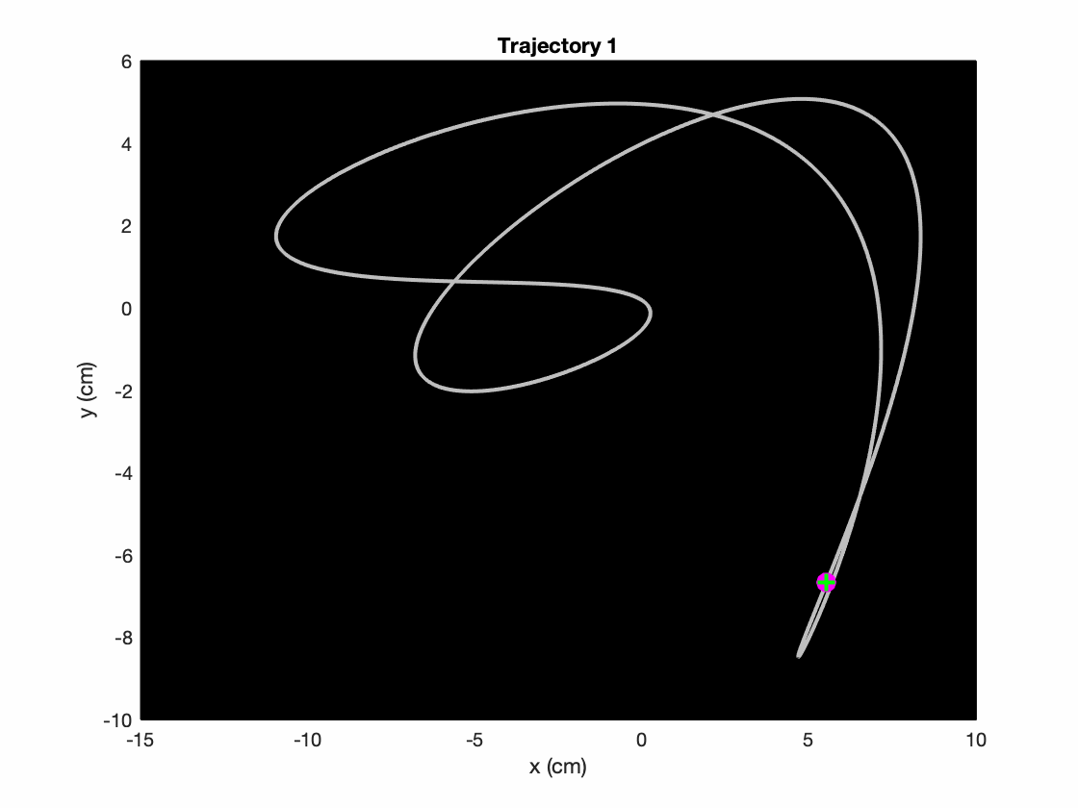
Methods
Procedure
EYE-TRACK
HAND-TRACK
Notes:
- EYE-TRACK: track target as accurately as possible with eyes while hands are immobile

Slide 10
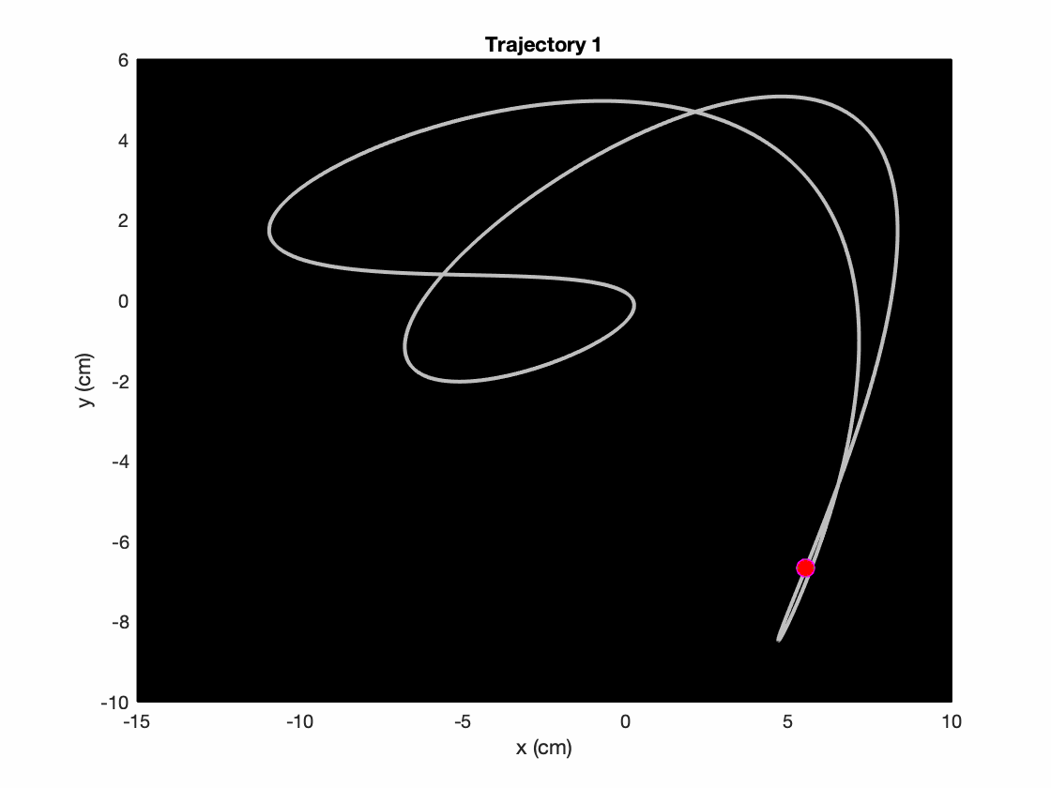
Methods
Procedure
EYE-TRACK
HAND-TRACK
Notes:
HAND-TRACK: track target as accurately as possible with cursor (i.e. hand)
No explicit instructions about what to do with gaze

Slide 11
Methods
Protocol
5 familiarization trials
1 block of 10 trials
Repeat for both conditions
Counterbalance first condition across participants
Total = 20 trials

Slide 12
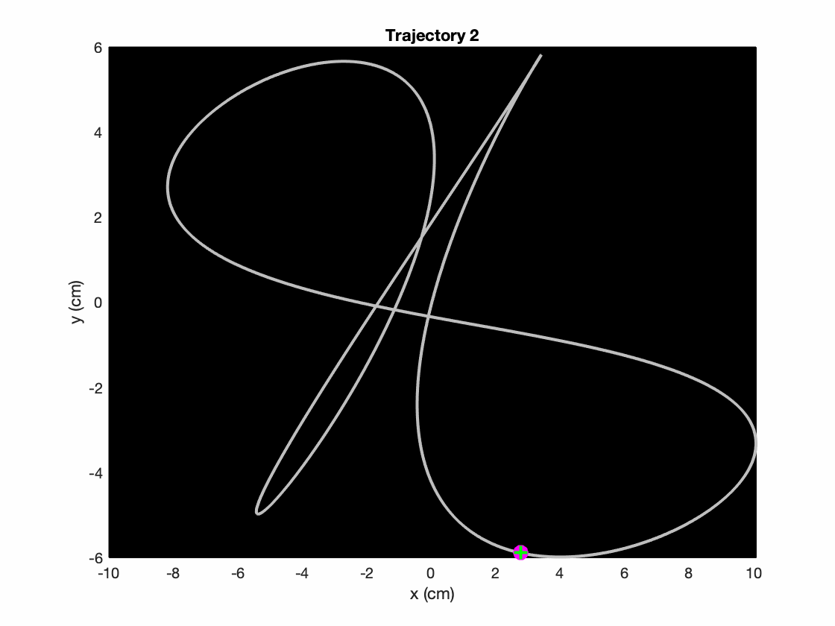
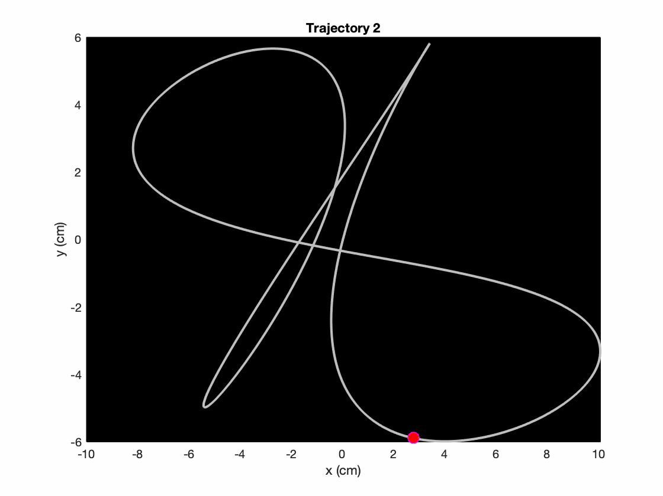
Methods - Procedure
EYE-TRACK
HAND-TRACK

Slide 13
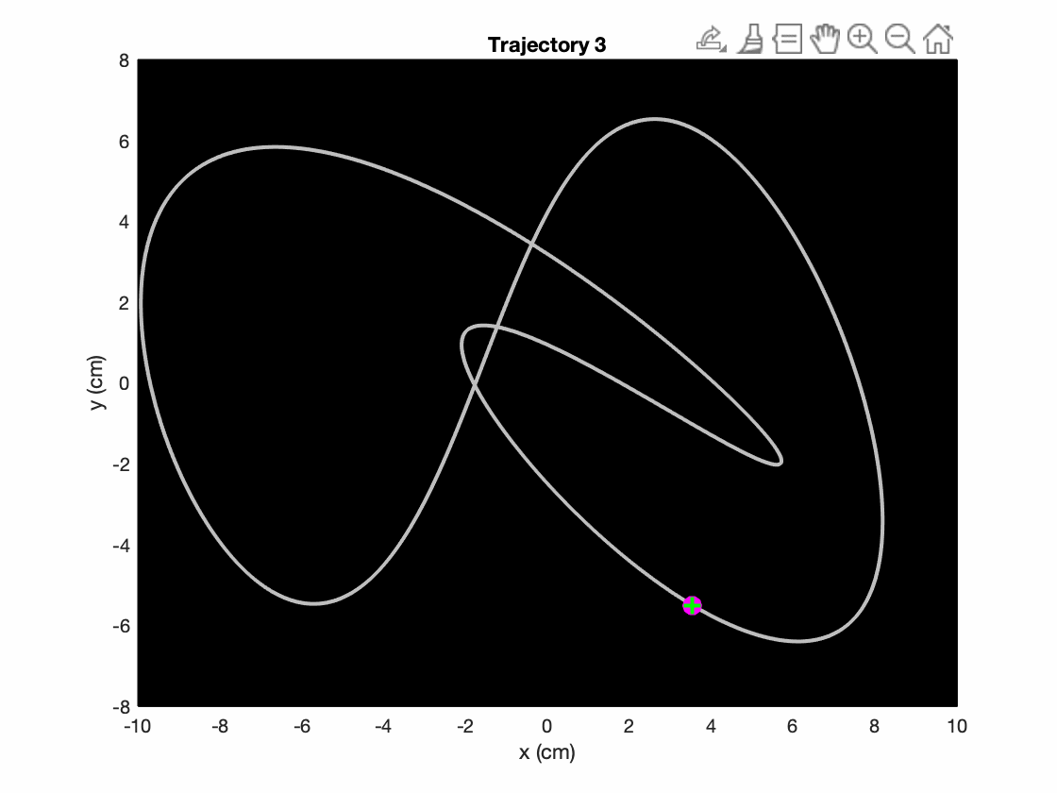
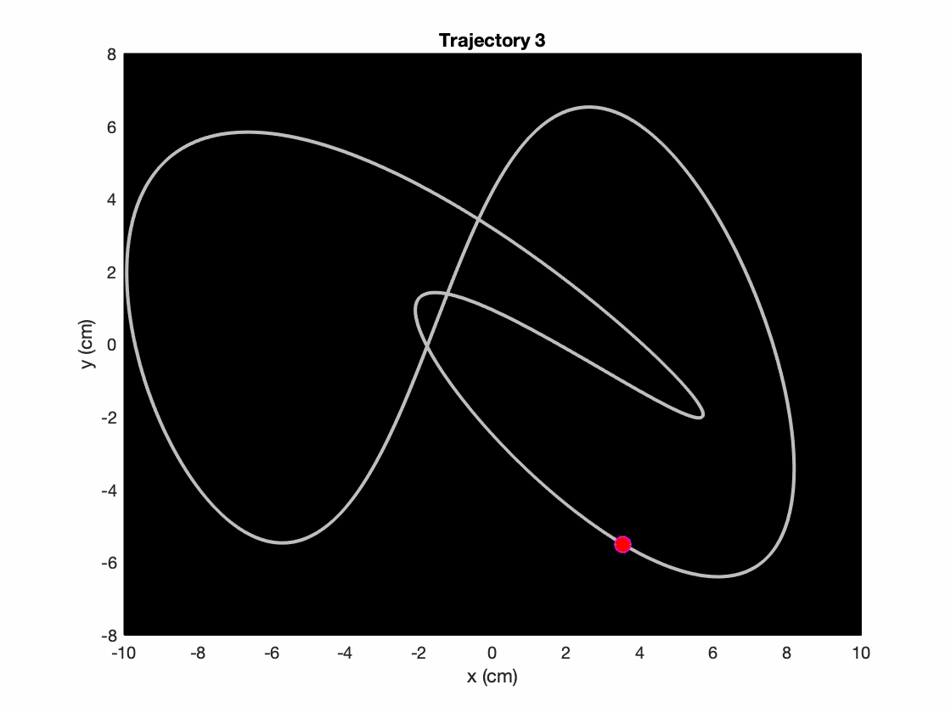
Methods - Procedure
EYE-TRACK
HAND-TRACK

Slide 14
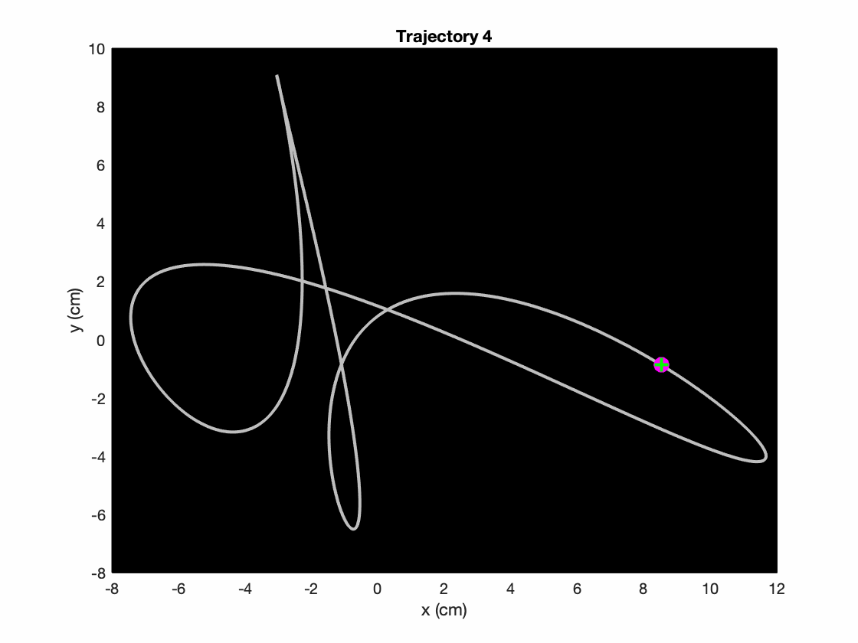
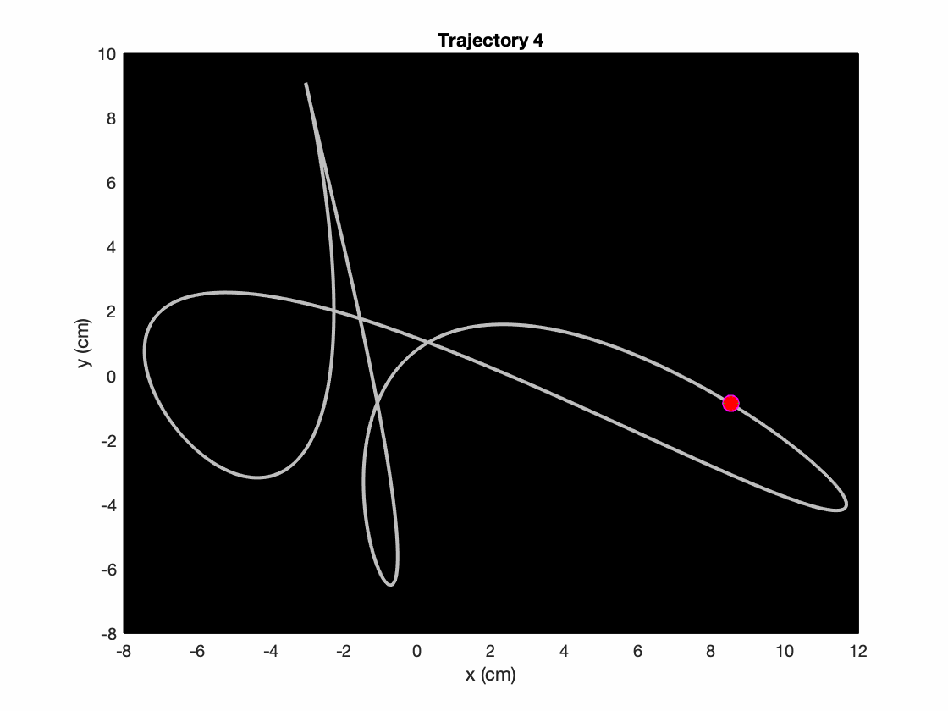
Methods - Procedure
EYE-TRACK
HAND-TRACK

Slide 15
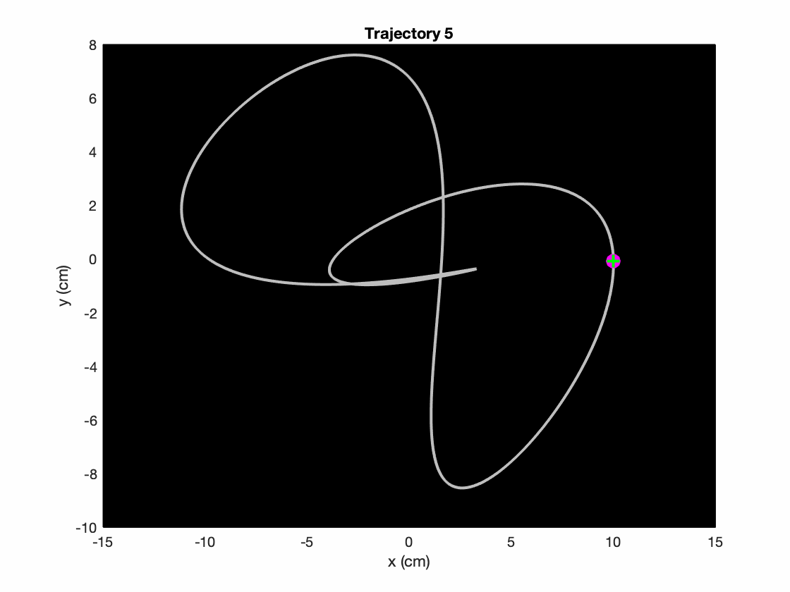
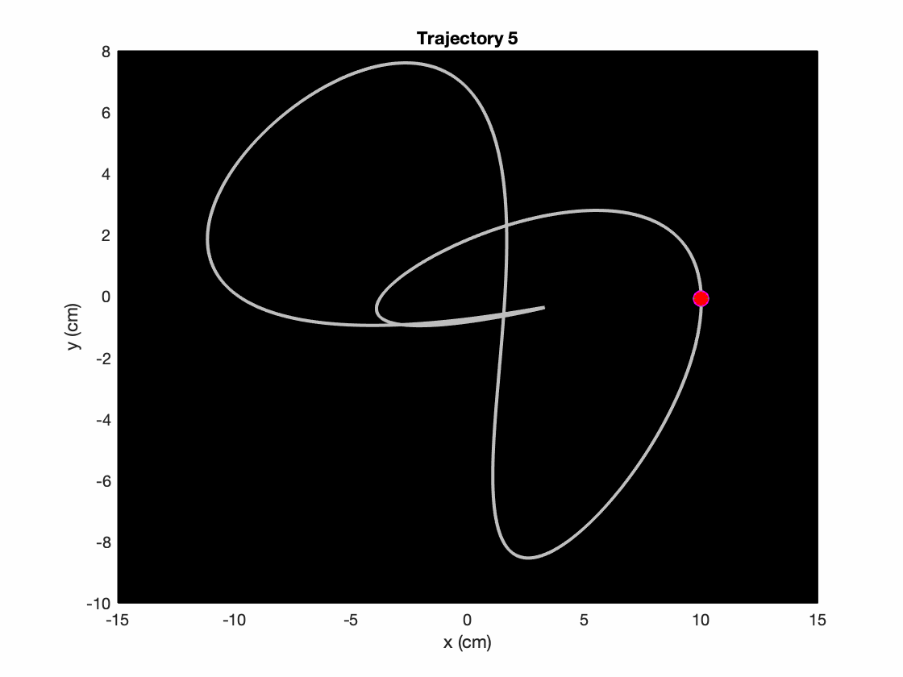
Methods - Procedure
EYE-TRACK
HAND-TRACK

Slide 16
Data Analysis
Pre-process
Remove blinks (visual inspection)
Low-pass filter with 4th order Butterworth w/ cutoff frequency of 25 Hz
Differentiate to get velocity
Low-pass filter with 4th order Butterworth w/ cutoff frequency of 25 Hz
To remove noise from differentiation
Differentiate to get acceleration
Low-pass filter with 4th order Butterworth w/ cutoff frequency of 25 Hz
To remove noise from differentiation

Slide 17
Data Analysis
After pre-process
Saccades = acceleration and deceleration peaks of > 1500 cm/s²
Extracted periods of pursuit and saccades
Dependent variables
Spatial relationship
Mean Euclidean distance between gaze position and target position
Mean Euclidean distance between hand position and target position

Slide 18
Data Analysis
Dependent variables
Temporal relationship
Interleave x and y signals & time shift by two samples
Gaze relative to target and cursor
Project gaze onto axis connecting target and cursor and determine relative position such that:
0 = gaze on target
1 = gaze on cursor
For each trial, distribution of relative gaze position was inspected
Fig 3.

Slide 19
Data Analysis
Characterize saccades and smooth pursuits
Mean saccade rate (saccades / second)
For each saccade:
Amplitude, duration, accuracy (with respect to target)
Mean tangential velocity
Gain = gaze tangential velocity / target tangential velocity
Only when target tangential velocity > 10 cm/s

Slide 20
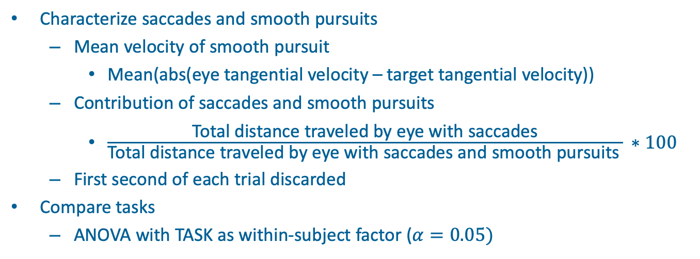
Data Analysis
Characterize saccades and smooth pursuits
Mean velocity of smooth pursuit
Mean(abs(eye tangential velocity – target tangential velocity))
Contribution of saccades and smooth pursuits
$\frac{\text{Total} \text{distance} \text{traveled} \text{by} \text{eye} \text{with} \text{saccades}}{\text{Total} \text{distance} \text{traveled} \text{by} \text{eye} \text{with} \text{saccades} \text{and} \text{smooth} \text{pursuits} } ∗100$
First second of each trial discarded
Compare tasks
ANOVA with TASK as within-subject factor ($α=0.05)$

Slide 21
Results
Typical trials
Gaze typically close to target
Small temporal delay
Small distance error
Lag (ms + cm) hand > Lag (ms + cm) eye
Less catch-up saccades in hand tracking compared eye tracking
Fig 4.

Slide 22
Results
Eye vs. Hand tracking performance
More accurate with eyes than hands
Mean distance between eye and target:
EYE-TRACK = 1.09 cm
Mean distance between cursor and target:
HAND-TRACK = 2.47 cm
Mean time between eye and target:
EYE-TRACK = 24 ms
Mean time between cursor and target:
HAND-TRACK = 108 ms

Slide 23
Results
Overall gaze behavior
Similar in 2 tasks (no main effects)
Fig 5.

Slide 24
Results
Fig 6.
Notes:
How gaze shared between target and cursor (HAND –TRACK)
Thick red = mean; dotted red = 1 SD

Slide 25
Results
Saccadic behavior
Average saccades per second
EYE-TRACK: 2.76
HAND-TRACK: 2.02
No amplitude difference
No saccade duration difference
Fig 7.

Slide 26
Results
Saccadic behavior
Smaller contribution of saccades during HAND-TRACK compared to EYE-TRACK
Fig 7.

Slide 27
Results
Saccadic behavior
Saccades initiated with similar positional error, final accuracy greater during HAND-TRACK
Fig 7.

Slide 28
Results
Smooth pursuit behavior
SP velocity in HAND-TRACK > EYE-TRACK (6%)
Fig 8.

Slide 29
Results
Smooth pursuit behavior
SP gain in HAND-TRACK > EYE-TRACK (8%)
Fig 8.

Slide 30
Results
Smooth pursuit behavior
SP velocity error EYE-TRACK > HAND-TRACK (17%)
Smooth pursuits overall performance
HAND-TRACK > EYE-TRACK
Fig 8.

Slide 31
Results
Correlation across tasks and participants
Gaze behavior in two tasks positively correlated across participants in:
Saccade rate, saccade amplitude, saccade duration, saccade accuracy, SP gain, SP velocity error, eye-target distance

Slide 32
Discussion
Similarities in gaze behavior during eye and hand tracking
Gaze typically directed towards target
To track target, brain needs to monitor target and hand positions
Monitor target position with eye
Monitor hand position with proprioception and/or peripheral vision

Slide 33
Discussion
Dissimilarities in eye motion during eye and hand tracking
Less frequent catch-up saccades during HAND-TRACK
Less saccadic suppression
Higher SP Gain during HAND-TRACK
Suggesting gaze behavior is driven by different demands when tracking target with hand / eye
Similar findings for smooth pursuit gain and saccade frequency from other experiments that instruct participants to follow target with eyes
Explicit instruction may be unnecessary

Slide 34
Discussion
Limitations
Depth
One eye motion
Horizontal plane only (movements and vision)
Controls only
Neural structures: cerebellum or parietal cortex

Slide 35
Conclusions
Tracking externally-moved target with eye or hand influences eye behavior
Adds to idea that eye motion allows gathering relevant information for future and ongoing hand movements

Slide 36
Mantis Shrimp
How well is proprioceptive information, specifically position sense, transformed and utilized by the skeletal motor system and ocular motor system?
Is there a difference in perceived position sense between neurologically intact people and those who have had a stroke (FIM > 35)?
When using limb mirror match end position as a proxy for perceived position
When using eye mirror match end position as a proxy for perceived position

Slide 37
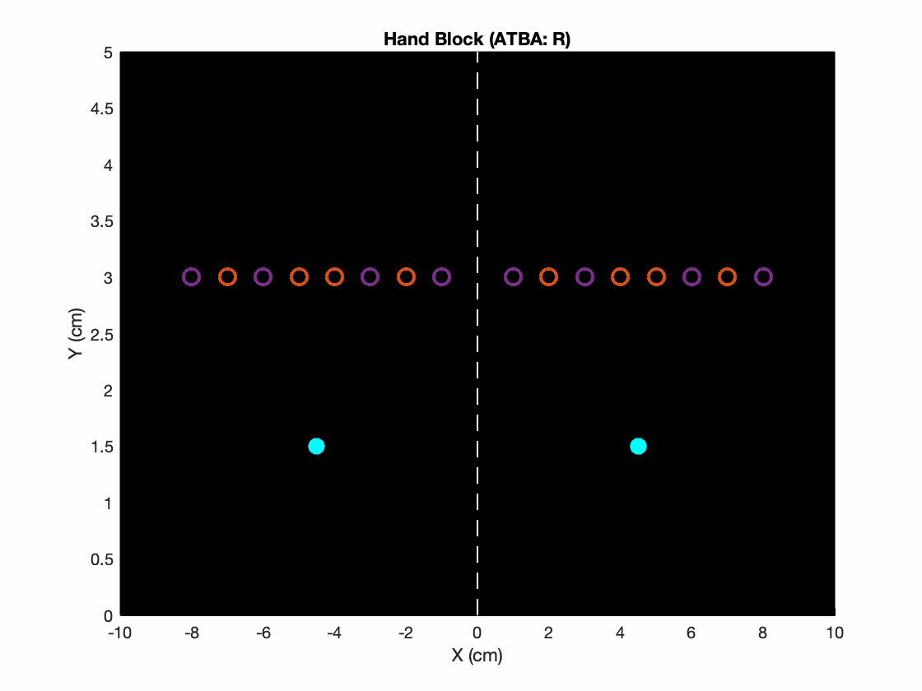
Mantis Shrimp
Participant only see cyan color
Robot move = red
Participant move = blue
True targets = Purple
Catch targets = Orange

Slide 38
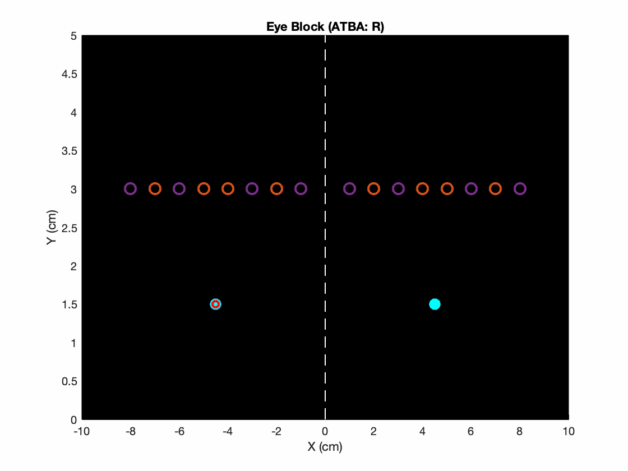
Mantis Shrimp
Participant only see cyan color
Robot move = red
Participant move = blue
True targets = Purple
Catch targets = Orange

